Slide 1
Beyond Libraries:
Careers for Info Pros
Outside the Hallowed Halls of Libraries
Naomi House, MLIS
Founder & Publisher of INALJ.com
August 23, 2013
VASLA CAREER CONNECTION EVENT
Chesapeake Public Library

Slide 2
What is INALJ?
And who is Naomi House?

Slide 3


INALJ (I need a Library job)
Naomi House, MLIS
Graduate of Rutgers
Government Contractor for a Federal Library
Hint we deal with statistics
Founded INALJ Daily Jobs Digest
And INALJ.com
And I worked full time, went to school & ran my husband’s website

Slide 4
INALJ Today: Success Story
2,155,862 views on INALJ.com!!!
1,040 have found jobs!!!
5,350 Facebook fans
3,651 Twitter followers
3,463 LinkedIn Group members
Notes:
http://inalj.com/?p=4857

Slide 5
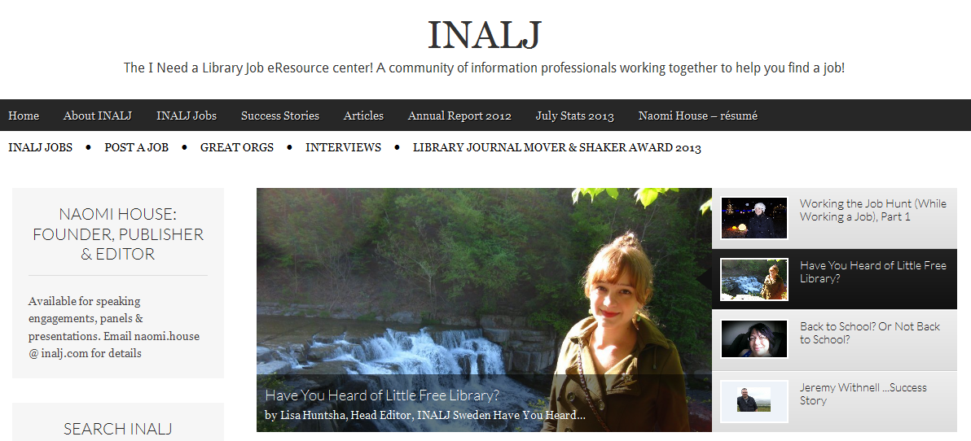

Slide 6
KEYWORDS FOR JOB SEARCHING
Librarian
Library
Information Professional
Taxonomist
Taxonomy
Database
Database Designer
KM
Knowledge Management
User Interface Designer
Community Manager
Knowledge Architect
Data Management Analyst
Information Architect
Social Media
Technology Trainer
Technology Futurist
Database Designer
Metadata
Knowledge Coordinator
Indexing
Indexer
Digital Content Curator
Transactional Law Researcher
Content Strategy
User Experience Design (UXD)
Project Analyst
Information Resource Officer
Certified Records Manager
MARC
Social Marketer
Intelligence Analyst
Open Source
Trainer
Teacher
the name of your ILS
Informationist
Informatician
Data Scientist
Big Data
Information Policy
Information Privacy
Information Recovery
Data Curator
DBA (Database Administration/ Administrator)
Chief Information Officer (CIO)
GIS (Geographic Information Systems)
Archivist
Archives
Program Analyst
Competitive Intelligence
Data Visualization
Market Analyst

Slide 7

Competitive Intelligence
Via Sabrina Pacifici’s LLRX.com guide
Researches companies to find a competitive advantage
Using legal, above-board resources including search engines
How to find and profile companies and people
Online tools for client/prospect monitoring
How to Follow Market Trends
Law Firm and Legal Industry CI
Notes:
Taken from Sabrina Pacifici’s annual guide to Competitive Intelligence on LLRX
http://www.llrx.com/features/ciguide.htm

Slide 8
Informationist
Via the NIH National Institutes for Health
“A special liaison or librarian-in-context program that augments your information resources,
saves you and your staff time,
and most importantly, enhances the quality of research and patient care.
The informationist provides personalized, on-site information services for your team.”
Basically- a SUBJECT SPECIALIST
With advanced training!
Notes:
Taken from the NIH.gov website
http://nihlibrary.nih.gov/Services/Pages/Informationists.aspx

Slide 9
Knowledge Manager
Via SLA and AALL SLA and AALL
What it is:
Capture, Analysis, Search,
Collaboration, Process
What it is not: Magic, Tech only, or Easy
Managing the flow of information
Be the organizations’ content curator
Organization can add more value than the info alone
Notes:
Taken from SLA and AALL presentation
http://vimeo.com/37756601

Slide 10
MORE TO KNOW ABOUT:
Data Visualization
Alberto Cairo, Nathan Yau, etc
&
Transactional Law Researcher
My Story

Slide 11
KEYWORDS FOR JOB SEARCHING
Librarian
Library
Information Professional
Taxonomist
Taxonomy
Database
Database Designer
KM
Knowledge Management
User Interface Designer
Community Manager
Knowledge Architect
Data Management Analyst
Information Architect
Social Media
Technology Trainer
Technology Futurist
Database Designer
Metadata
Knowledge Coordinator
Indexing
Indexer
Digital Content Curator
Transactional Law Researcher
Content Strategy
User Experience Design (UXD)
Project Analyst
Information Resource Officer
Certified Records Manager
MARC
Social Marketer
Intelligence Analyst
Open Source
Trainer
Teacher
the name of your ILS
Informationist
Informatician
Data Scientist
Big Data
Information Policy
Information Privacy
Information Recovery
Data Curator
DBA (Database Administration/ Administrator)
Chief Information Officer (CIO)
GIS (Geographic Information Systems)
Archivist
Archives
Program Analyst
Competitive Intelligence
Data Visualization
Market Analyst

Slide 12
INALJ.com

Slide 13

Notes:
Questions?

